Slide 1
Emergency Animal Handling
Canine and Feline

Slide 2
Emergency Animal Handling
Move slowly – be aware of your surroundings
Have an escape plan
Remember, your safety is FIRST priority
Ask for help if you think it is beyond your training, experience
Use your tools properly
STAY CALM!!!!!!!!
Look for invisible fence collar
Look for notes an owner may have left in a very obvious place
MUZZLE, MUZZLE, MUZZLE!
Use a Slip Lead – don’t attach leash to a collar and NEVER take a hold of a dog by its collar
Demo use of equipment
Loading a difficult dog – what do you do?

Slide 3
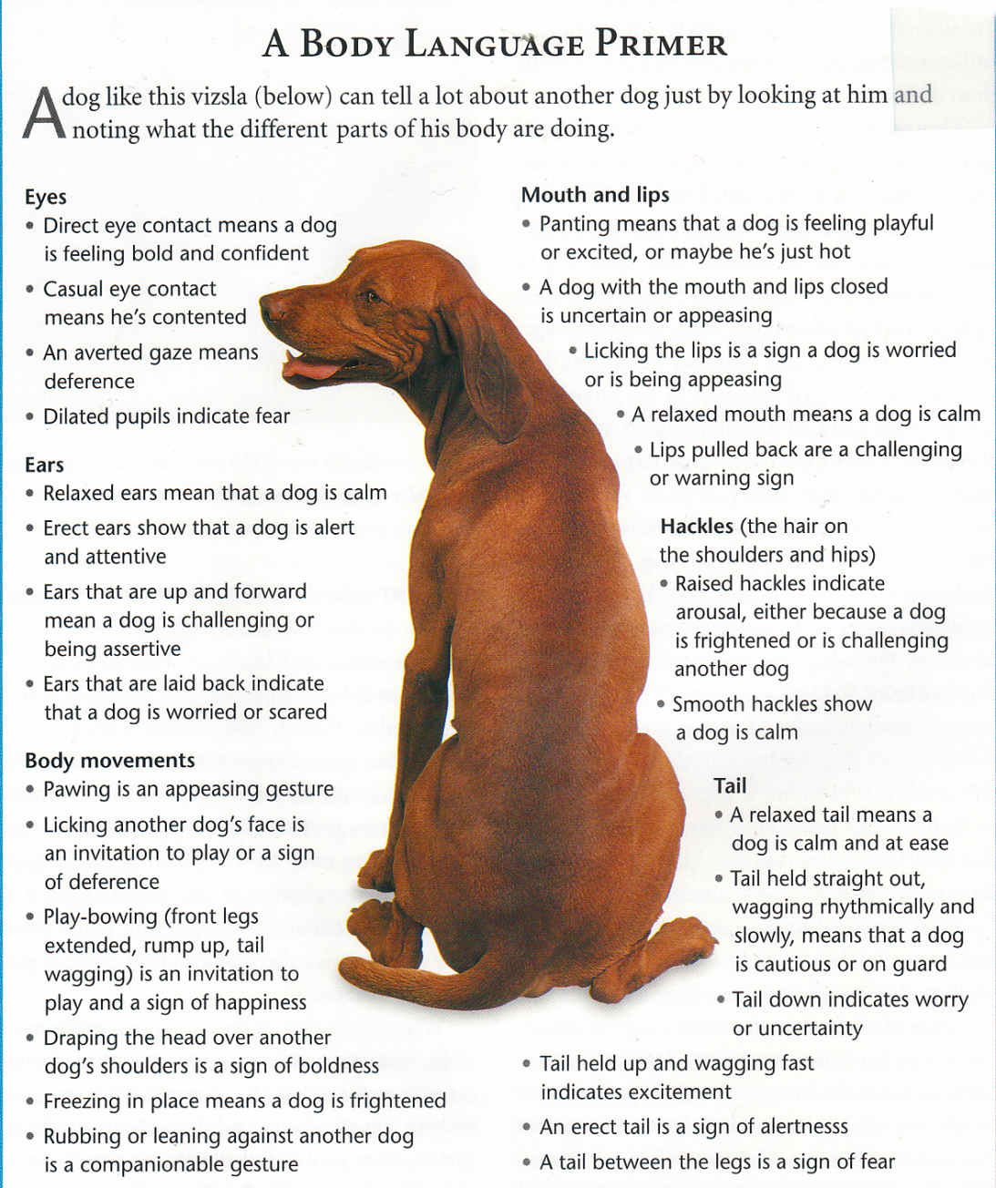
Body Language – SO IMPORTANT!

Slide 4
Body Language Communication
Dogs are far better at sending and receiving body language messages than they are at vocal communication. Dogs understand each others’ body language signals: postures, facial expressions and movements. Humans vary in understanding, though. Some of us understand the body language patterns of dogs and other do not. Humans communicate a great deal with dogs through body language. It may however take the dog some time to get OUR message.

Slide 5
Vocal behavior in dogs
VOCAL COMMUNICATION
Dogs produce a wide variety of sounds. Dogs use their vocals to achieve communication with other dogs, and with humans. Sounds are more favorable for communicating with humans, though. Examples of dog sounds include: barking, whimpering, muttering and growling.
Dogs associate sounds with reinforcement from humans. If a dog barks furiously and is immediately attended to, it will associate barking with attention
Sounds and their Interpretations:
  The howl – Used for long-distance communication, and implying loneliness or misery
  The whimper – expressing anxiety or misery
  The growl – communicating warning
  The whine – implying frustration, may also be associated (as above) with attention-getting
  The bark – there are many forms of barks, with different meanings:
    The greeting bark: expresses excitement and happiness
    The alarm bark: expressing warning or threat
Dogs understand hard consonant sounds most easily. However, overall, there are numerous short-comings of vocal communication. Body language comes in to fill these communication gaps.

Slide 6
Friendly
ears pointed slightly forward
smooth hair coat
vertical tail
head bunting
whiskers pointed sideways (relaxed)
whiskers fanned out, pointed forward (alert)
nose-to-nose touching
vocal murmur or acknowledgment

Slide 7
Fearful
dilated pupils
whiskers pulled back along face
tail may lash or be tucked close to body
hair coat may be raised along back and tail
hissing, growling, or spitting
flattened ears pointing down and back
crouched body, often facing sideways to opponent

Slide 8
Playful
dilated pupils
ears pricked forward
stalking movements
occasional chattering
various tail positions
fanned out, forward-facing whiskers

Slide 9
Submissive
ears held flat
smooth hair coat
tail down, close to body
dilated pupils, avoids direct eye contact
crouched position with head held down

Slide 10
Defensive Aggression
arched back
dilated pupils
whiskers pulled back along face
ears flattened, facing down and back
pilo-erection of hair coat
facing opponent sideways
mouth held open
hissing, growling, or spitting
tail held up and over the back or low to the ground or inverted “U” position
rolling onto its back to fight if there’s no means to escape
slapping the ground in front of it with its front paw

Slide 11
Offensive Aggression
tail down
lips curled into a snarl
direct stare with constricted pupils
fanned out, forward-facing whiskers
forward-facing body with hindquarters raised (ready to pounce)
pilo-erection of hair along shoulders and tail

Slide 12
Tail position
Tail wagging means the dog is excited or agitated (from a rise in energy level)
Tail up implies Confidence and dominance
Tail held horizontal and wagging slowly means the dog is being cautious
Tail held low or tucked implies fear and submission
Tail held relaxed and stationary signifies that the dog is contented

Slide 13
Head and neck position
Head and neck turned to side is a different expression.
Hanging head down (“hang dog”) means the dog is being submissive or is depressed.
Head in normal mid-way position means neutral condition. ‘Everything is all right.’
Head resting on other dog’s back demonstrates dominance.
Head held high with neck craning forward is exhibiting interest or perhaps, (depending on other signs) a challenge.

Slide 14
Position of the Torso
Rolling over implies submission or deference.
Urinating by squatting implies deference.
Tensing the muscles and raising the hackles implies a threat or imminent fight.
Play-bow - head low with the rump elevated: this implies happiness and often serves as an invitation to play.
Paws on top of another dog’s back implies dominance.
Backing implies the dog is unsure, possibly afraid.
Urinating by lifting the leg implies dominance or defiance.
Looming over implies dominance.
Humping implies dominance.

Slide 15
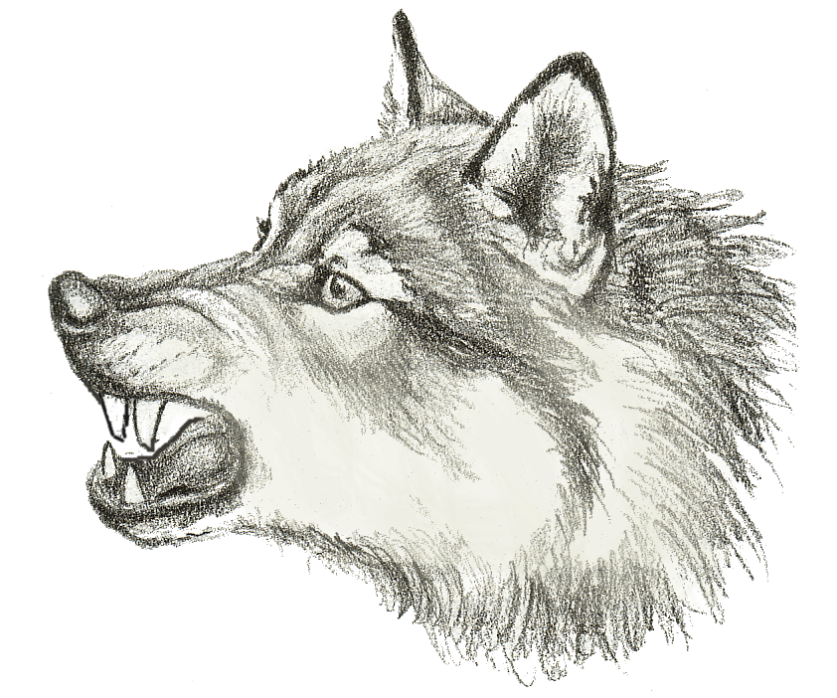
Aggression - Dominance

Slide 16
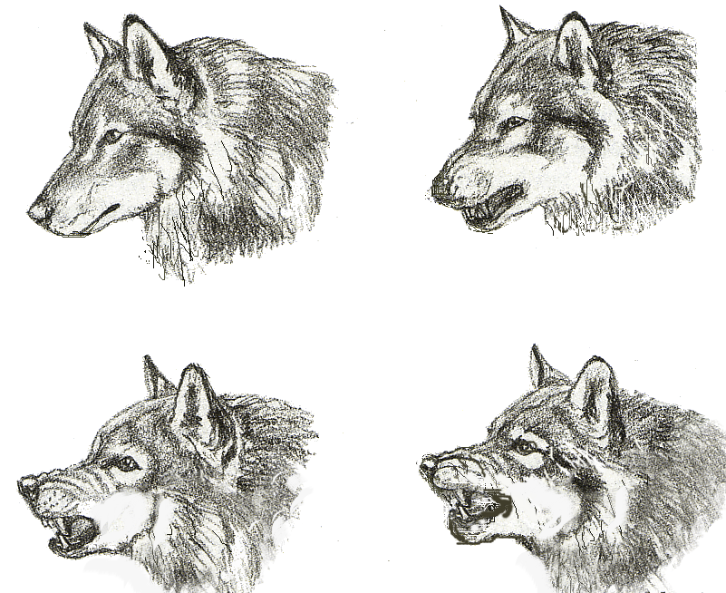
Canine – Dominance

Slide 17
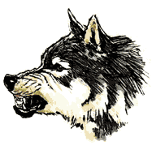
Dominance - aggression

Slide 18
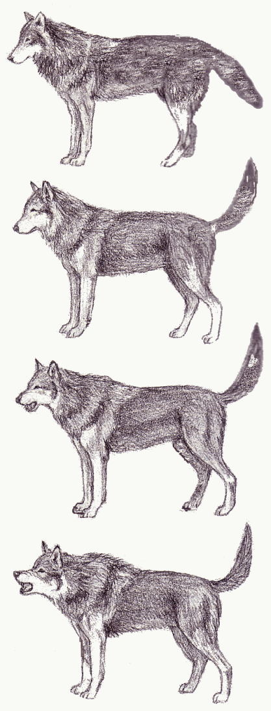
Canine – Dominance stages

Slide 19
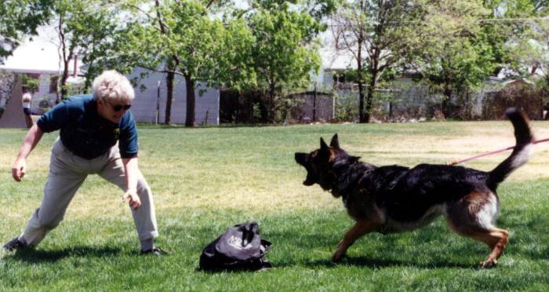
Dominance Aggression

Slide 20
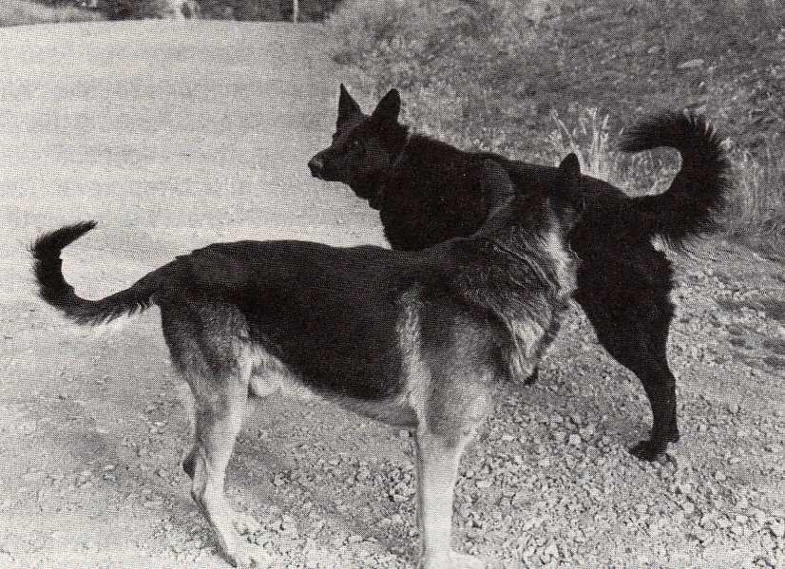
Dominant Dogs Meet

Slide 21
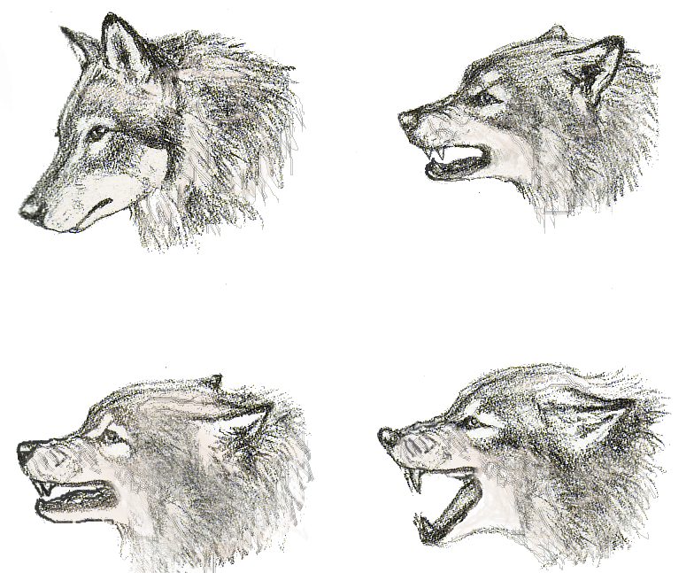
Canine - Fear

Slide 22
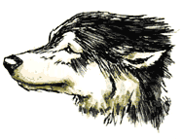
Fear - submission

Slide 23
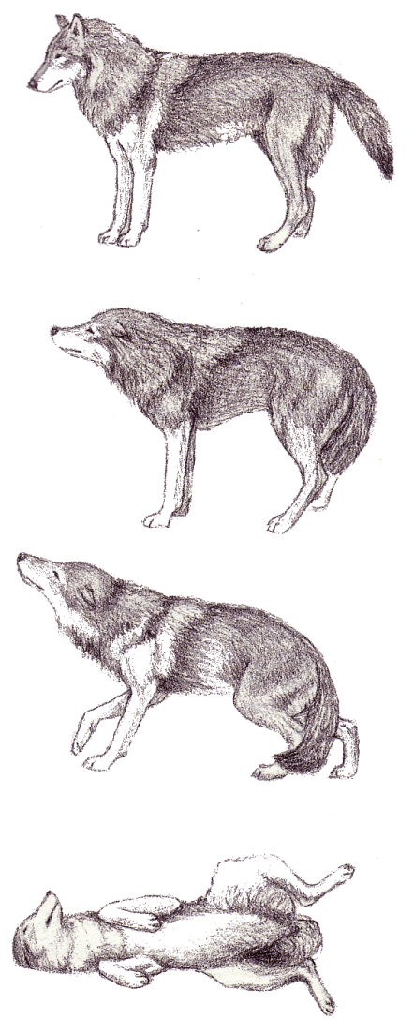
Canine – submission Stages

Slide 24
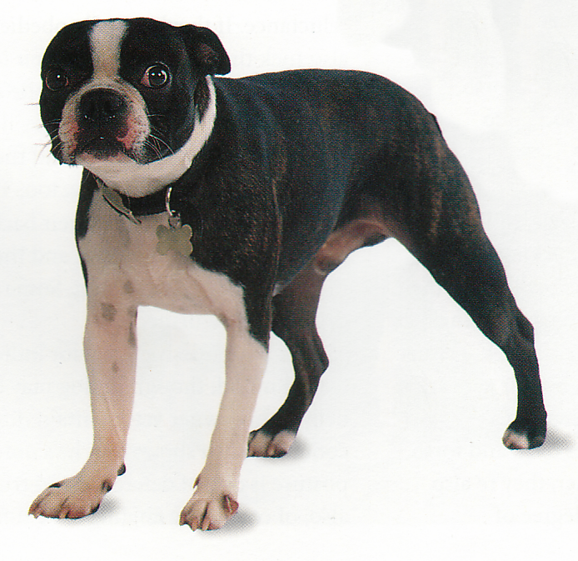
Back off

Slide 25
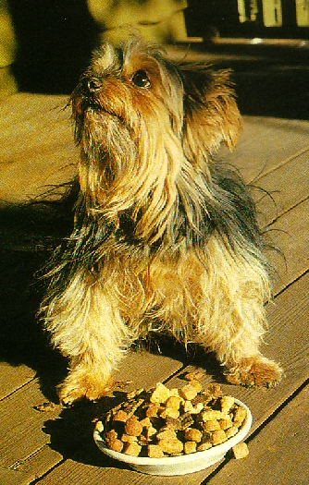
Back off

Slide 26
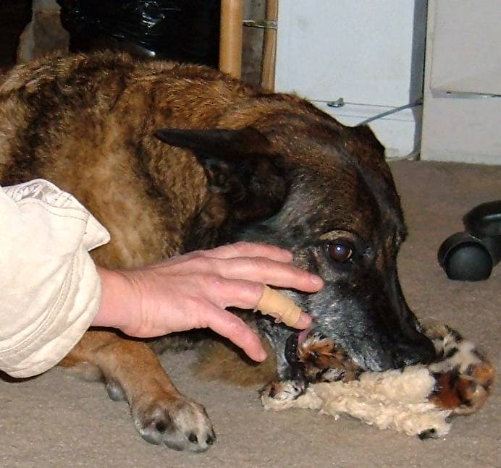
Back off – It’s mine

Slide 27
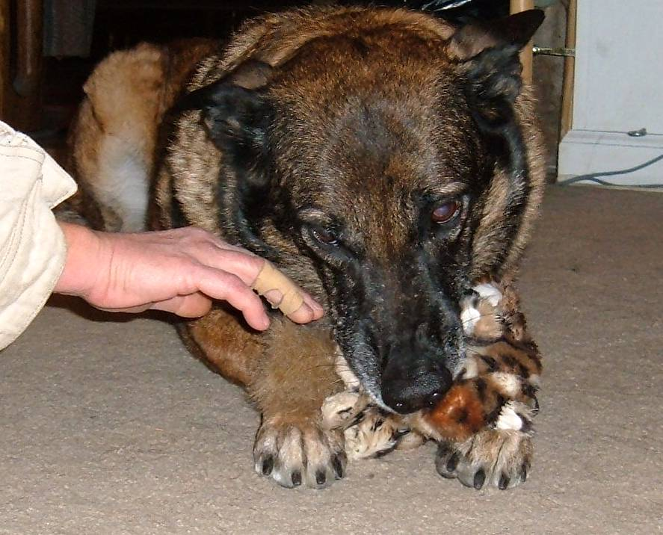
Back off – It’s mine

Slide 28
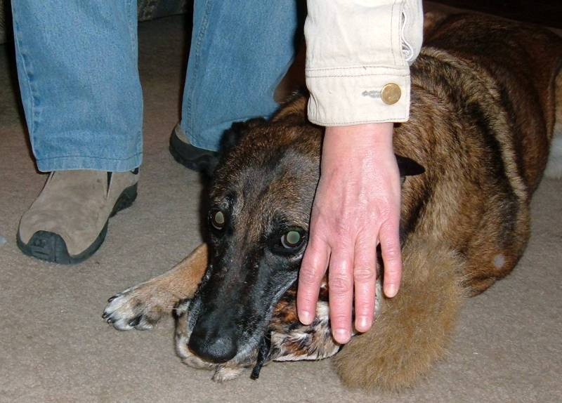
It’s still mine!

Slide 29
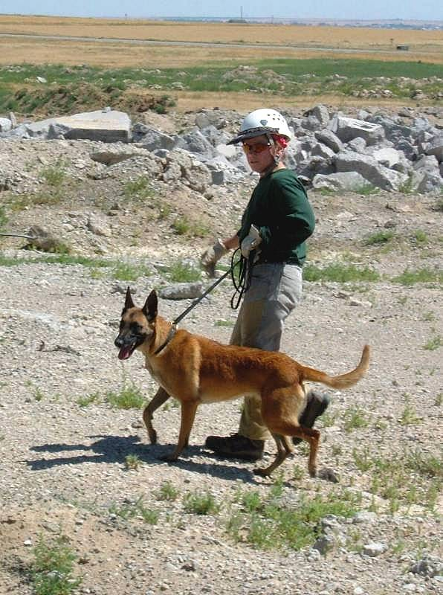
Confidence and excitement

Slide 30
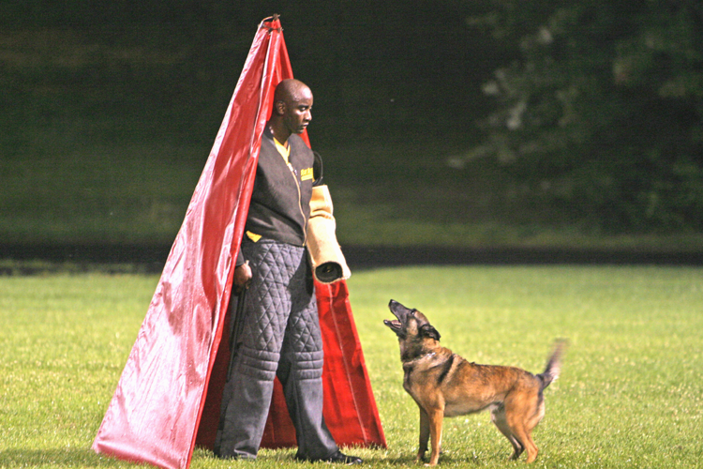
Confidence/slight worry - aggression

Slide 31
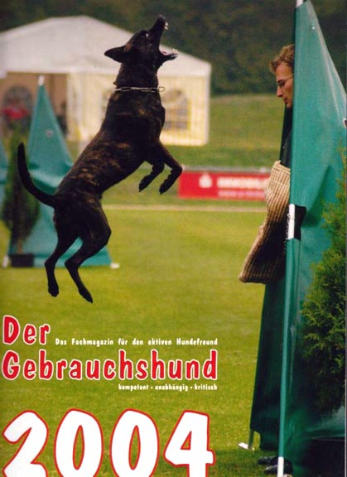
Confidence

Slide 32
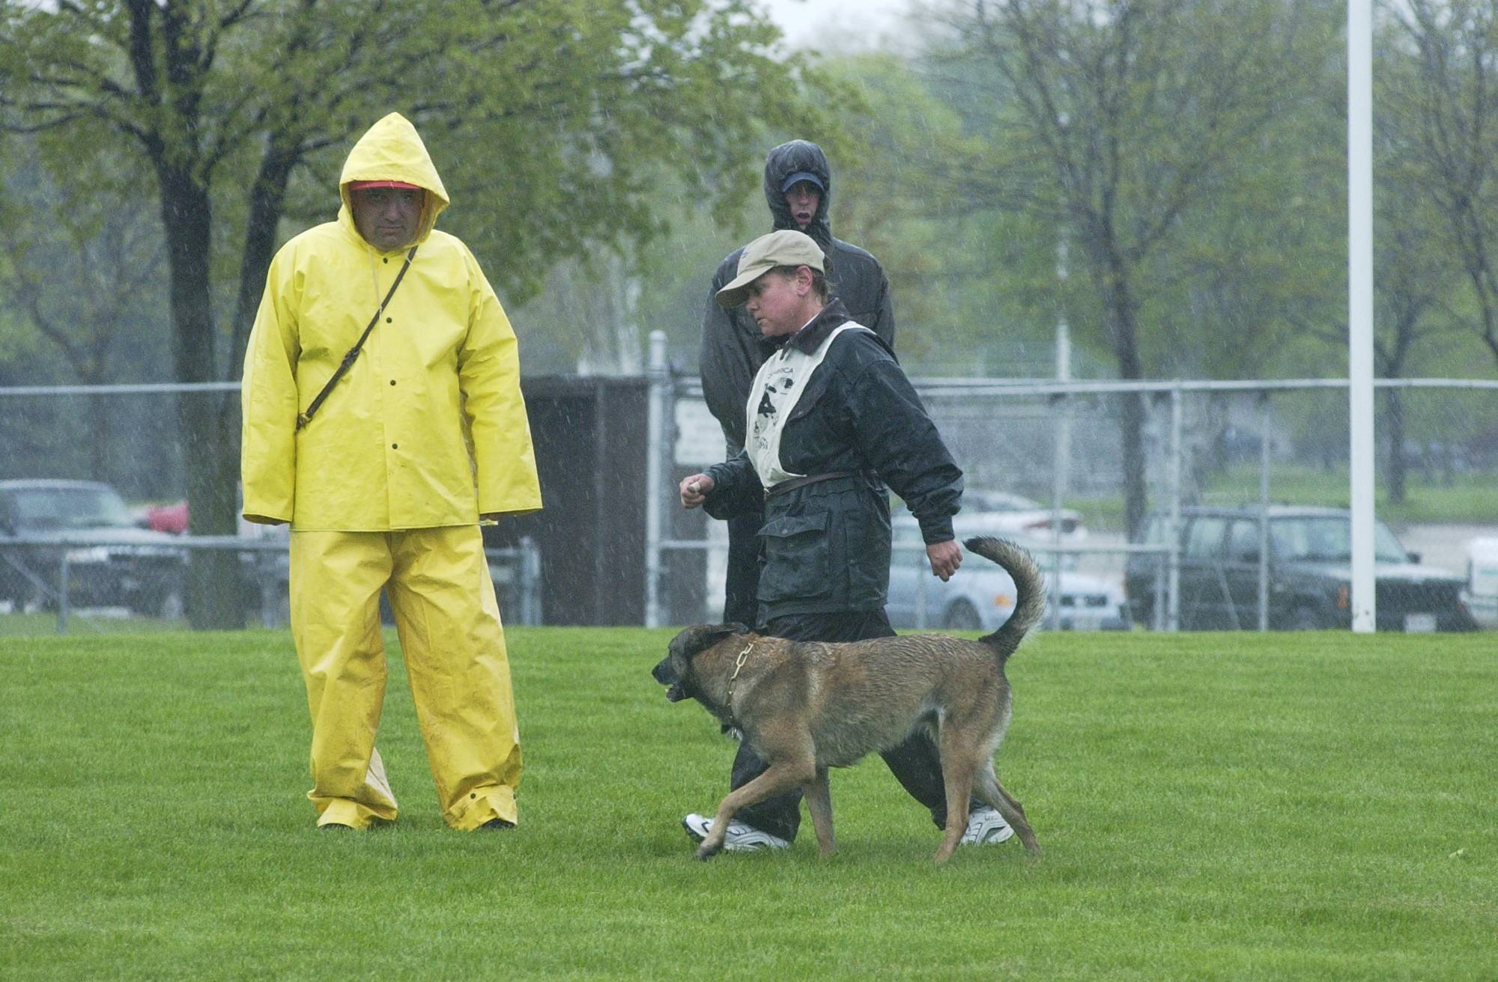
Suspicion – unsure but dominant

Slide 33
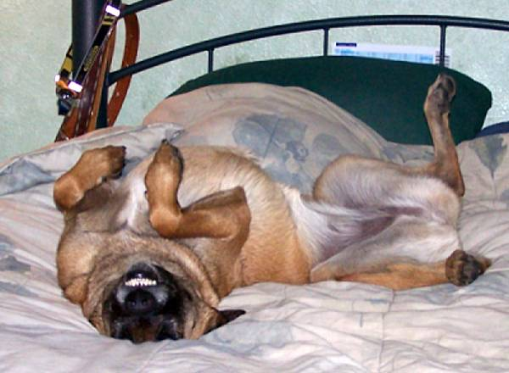
Smiling – what does it mean?

Slide 34
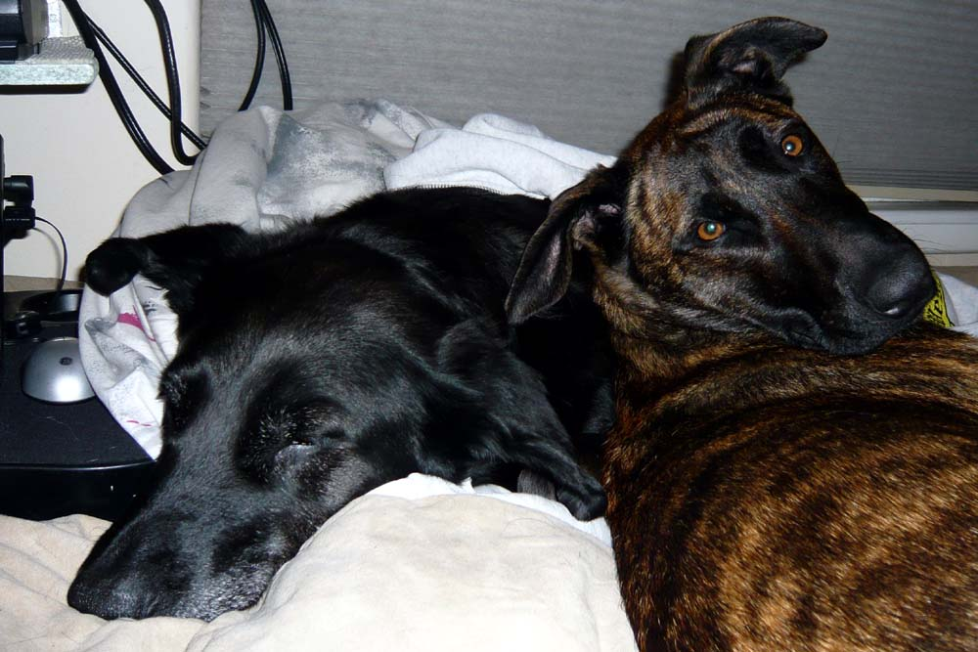
Watch the eyes - calm

Slide 35
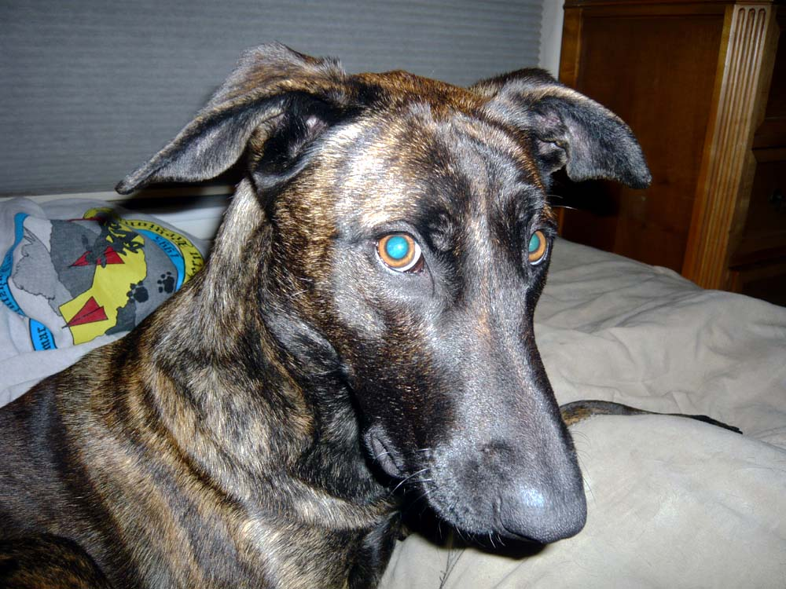
Eyes – startling to stimulate

Slide 36
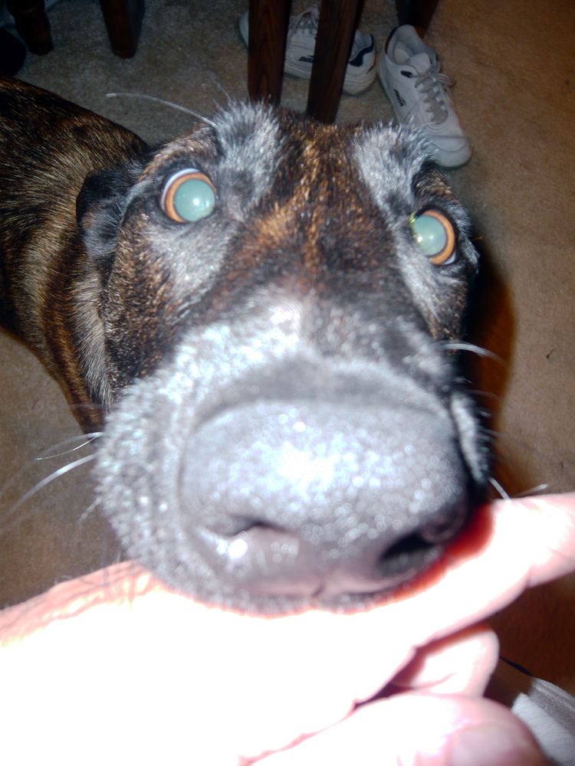
Eyes – Dilated - excitement

Slide 37
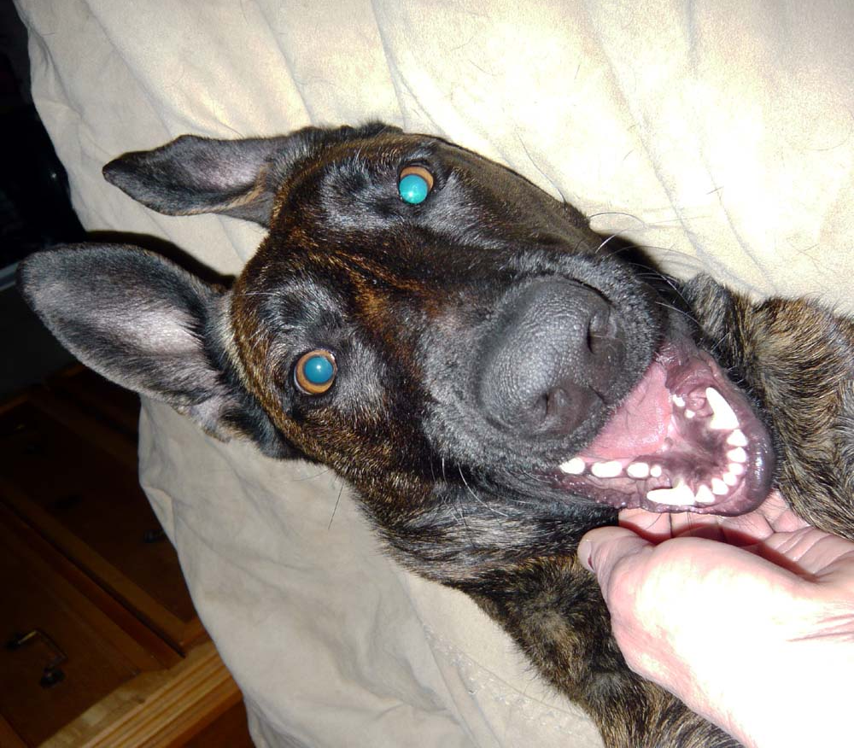
Eyes – you tell me

Slide 38
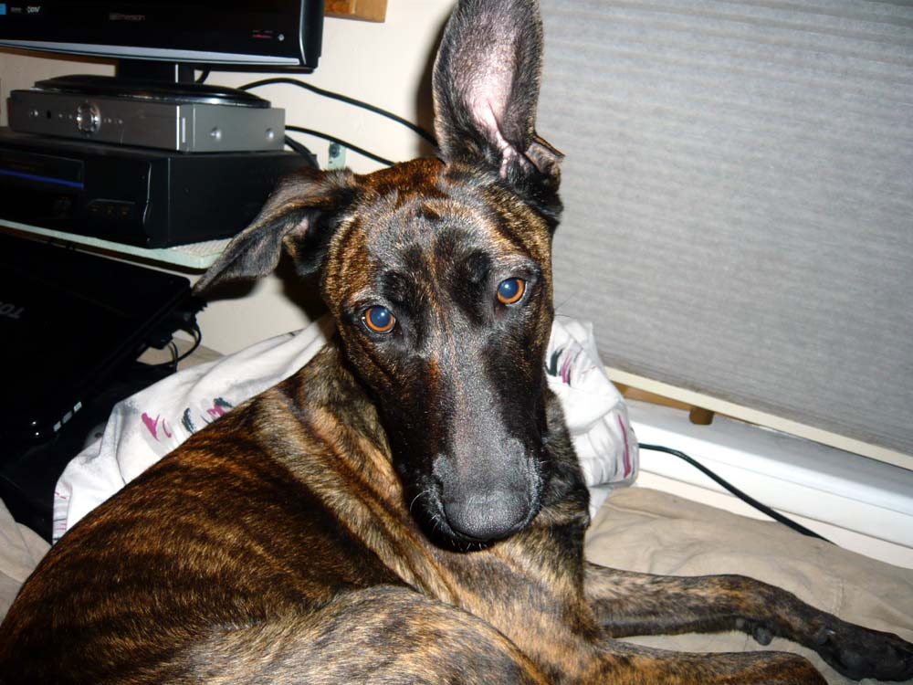
Eyes ??????

Slide 39
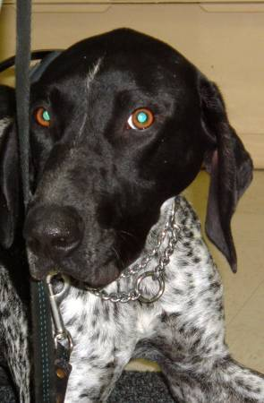
Am I happy???? Am I a threat??

Slide 40
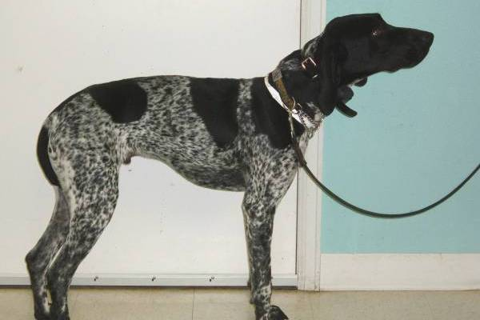
Dominant or submissive???

Slide 41
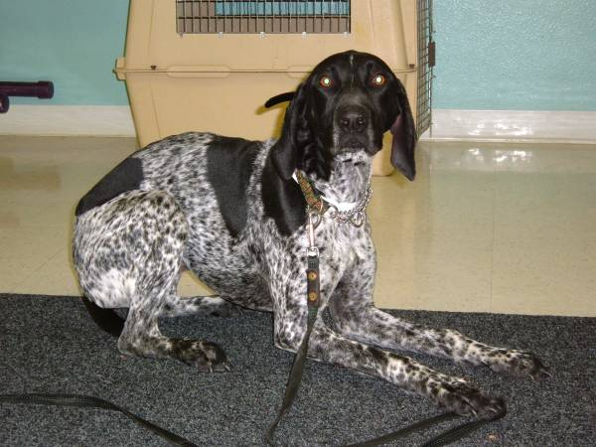
Scared?

Slide 42
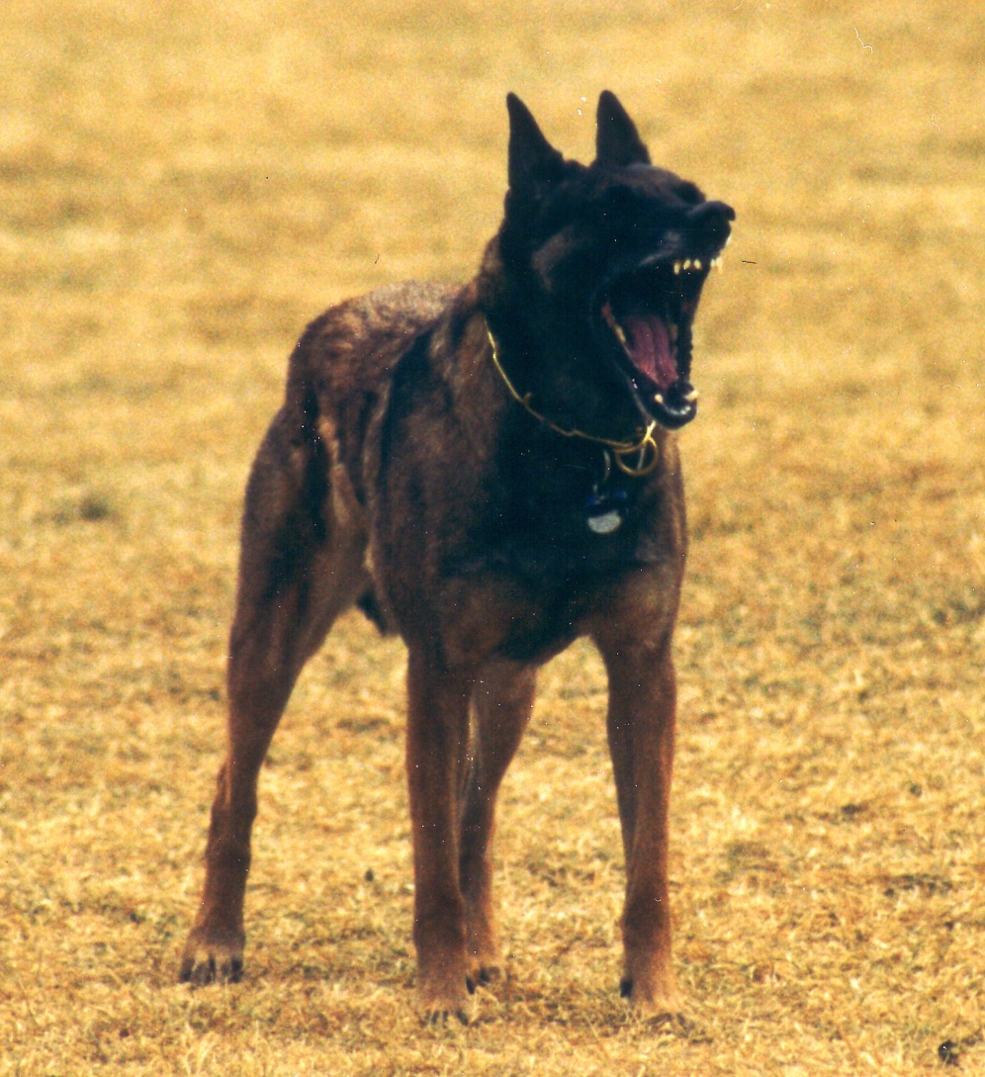
Does Yawning mean anything?

Slide 43
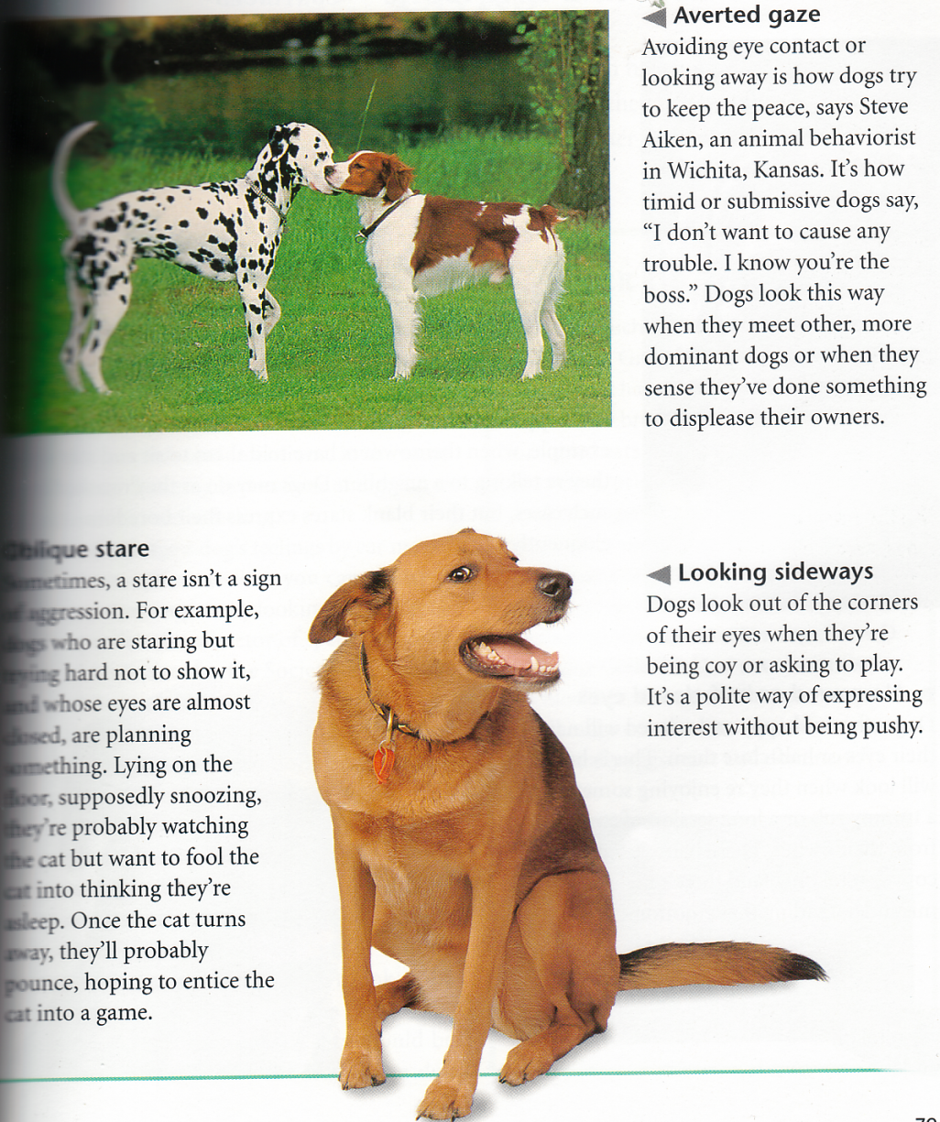
What are these dogs telling us??

Slide 44
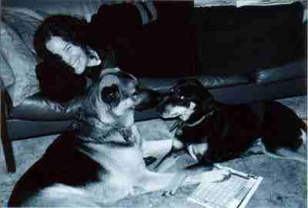
What are these dogs telling us?

Slide 45
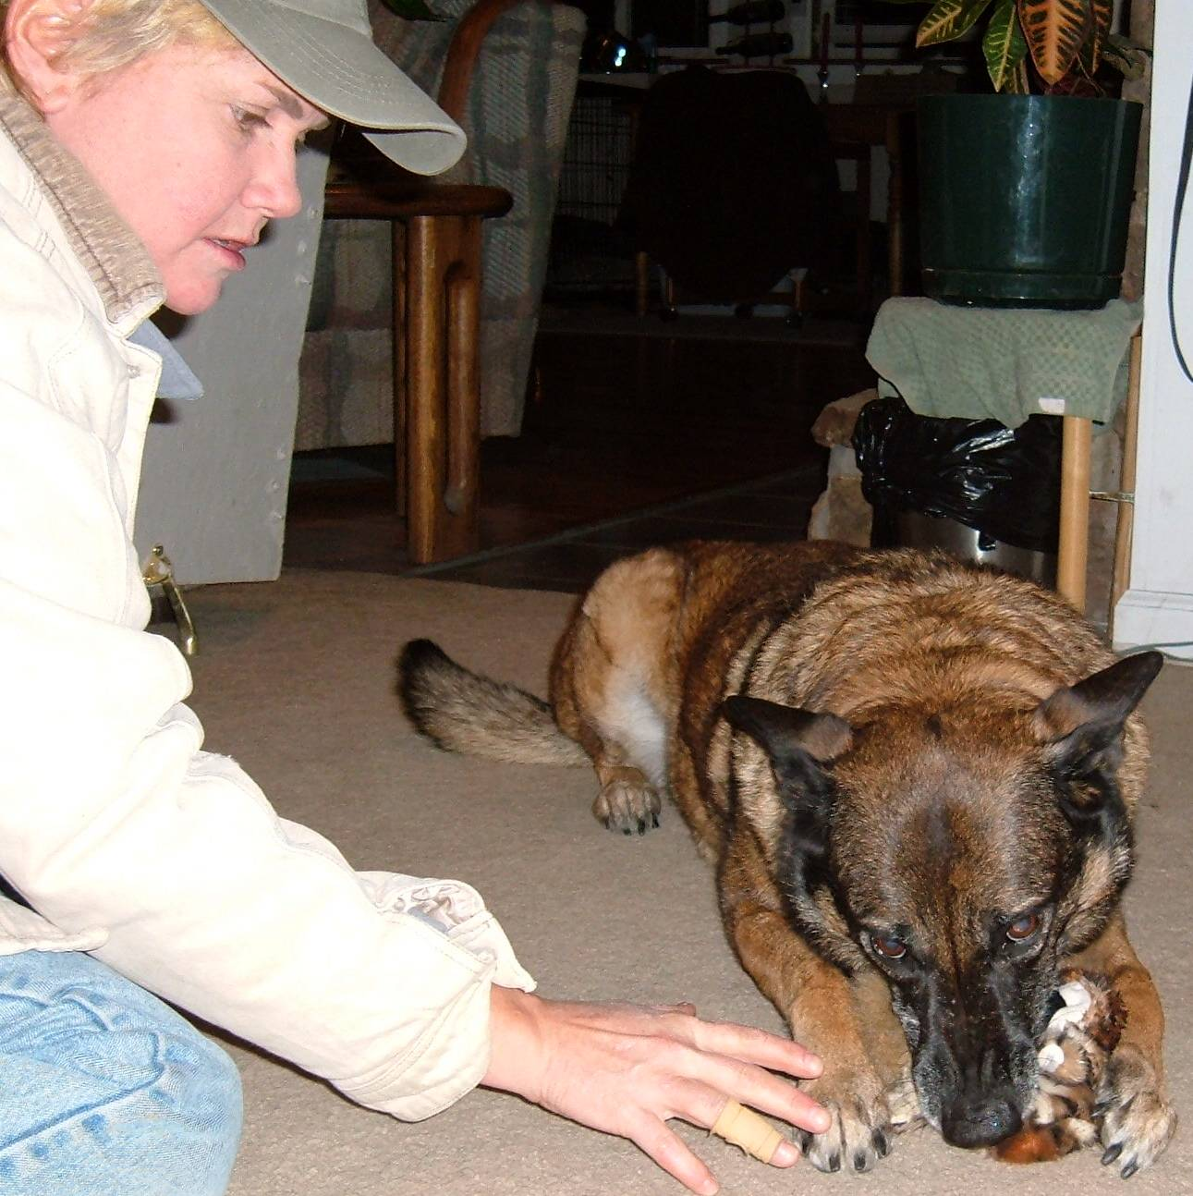
What is this dog saying???

Slide 46
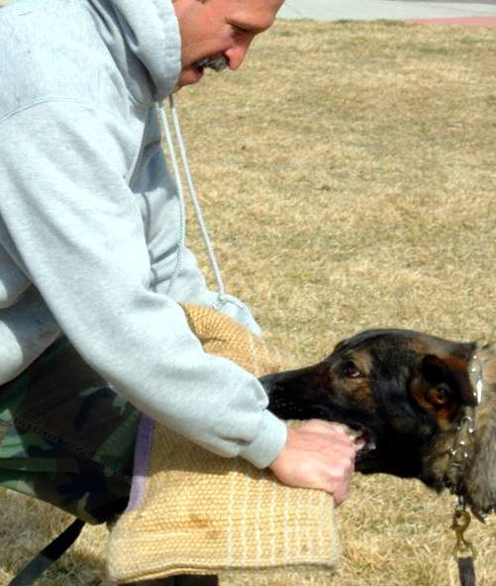
Dominant or submissive?

Slide 47
Simple reminders
! Always be aware of your body language when you are around a dog.
A dog giving conflicting verbal and physical messages will always attach greater importance to the physical.
Remember that a dog may interpret your body language in a different context than you intend.
Avoid physical movements that a dog might find threatening including: staring directly into the eyes, reaching over the head (even to attach a leash), stepping over the dog, leaning or pushing on the back, neck, or head, or pushing down on the rump.
Additionally, refrain from using quick or jerky movements around these dogs.
Never try to restrain a dog by holding the dog’s collar; use a leash!

Slide 48
Reminders
! Watch the dog’s body language.
Never rely on a dog’s tail to assess its state of mind. A wagging tail merely means that the dog is willing to interact—this could be good or bad! Instead, take into account all aspects of the dog’s body language.
Be wary around any dog whose demeanor includes staring, dilated pupils, wide-legged or stiff stance, lowered head, piloerection (raised hair along neck, back, or tail), bared teeth, growling, laid back ears, or a general stiffening of the body. If you observe a dog showing any of the above behaviors towards you, move slowly and quietly away from the dog keeping your side facing the dog and your eyes averted. If a dog is showing any of these behaviors towards another dog, gently move the dog (with the leash) away from the other dog.
NEVER RUN AWAY – KEEP YOUR EYES ON A DOG LIKE THE ONE DESCRIBED ABOVE WITHOUT STARING AT IT.

Slide 49
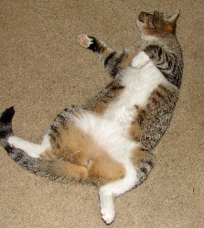
Cat behavior

Slide 50
Ears
The ears are another way that a cat expresses his/her emotions.
Ears pointing forward and slightly outward – your cat is relaxed and happy.
Ears very straight up and forward – your cat is listening to something that is intriguing.
Ears twitching nervously – your cat is agitated and nervous.
Ears flat against the head – your cat is frightened and may attack (this is instinctual as to protect the ears during a fight).
Ears back or in between alert and defensive position – your cat is aggressive and may attack.

Slide 51
Back and Fur
In general a cat’s body fur remains fairly consistent; however, if you notice your cat arching his or her back and bristling you can rest assured that your cat is frightened and on the defensive. Your cat may attack at this point.

Slide 52
Eyes/Pupils
Cat’s pupils for the most part change with the amount of the light in the room. However, if your cat becomes very aroused, excited or angered his/her pupils will become greatly enlarged regardless of the amount of light in the room.
Your cat’s eyes can also tell you a lot about what kitty is thinking:
  Wide open eyes – your cat is awake and ready to go
  Wide open eyes with a little sparkle – your cat is feeling a little mischievous
  Half closed eyes – your kitty is relaxed and ready for a cat nap! This can also mean your cat is ill if the eyes are like this on a consistent basis, even when awake.
  Closed eyes – your cat is napping, obviously.
  Winking/Blinking – A long slow blink means that your cat is content and relaxed.

Slide 53
Tails
Tail arched and puffed out or bristled – your cat is scared or fearful and is ready to attack or defend itself. The bristling is instinctual as it makes the cat look larger.
Tail straight up in the air and fully puffed out or bristled – your cat is angered, aggressive and ready to attack.
Tail straight up in the air and quivering a bit – your cat’s tail moves this way when spraying urine to mark territory; however, once your cat is spayed or neutered he/she will continue to move his/her tail this way (without any spray or urine being excreted) when you greet him/her. This is your cat’s way of saying, ‘hi, it’s your loving cat!’
Tail straight up and unmoving – an unabashed greeting. This is what a mother cat does to her kitten to tell him/her to inspect her rear.
Tail straight up but the tip tilted to one side – your cat is very interested and intrigued by something; your cat is happy and friendly.
Tail straight up or just slightly raised and curved like a question mark – your cat is very excited and interested in something.
Tail curved down and then back up again near the tip – your cat is very relaxed and content.
Tail still but tip of tail quivering or twitching – your cat is mildly irritated. Your cat may attack if the twitching becomes violent enough.
Tail swishing from side to side rapidly or violently – your cat is about to attack something; this is seen during fights and play time. This is not the same as tail wagging in dogs.
Tail held to one side – your cat is giving a sexual invitation (generally only females in heat do this).
Tail held low and puffed out or bristled – your cat is intensely afraid.
Tail held low and tucked between the hind legs – your cat is showing his submission or defeat.

Slide 54
Other behaviors
Kneading – this stems from ‘milk threading’ that kittens do. Kittens knead their mother’s belly to stimulate milk production. In doing this to you your cat is not only expressing his/her love for you as a mother-figure but also remembering the happy feelings that used to occur when the mother was kneaded.
Snoring – if your cat snores when he/she sleeps he/she is totally relaxed!
Sniffing – cats sniff each other in the wild to say hello and get to know each other. If your cat sniffs your face consider it a greeting and a way of showing that your cat trusts and likes you. Many owners even get down on the floor (face level with their cats) and touch noses when they greet.

Slide 55
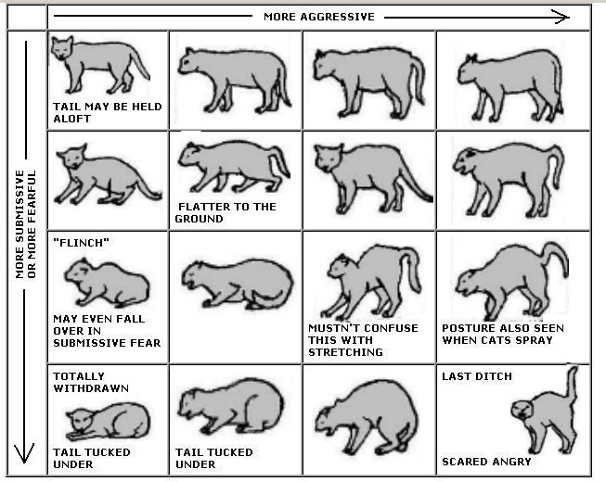
Cat Chat

Slide 56
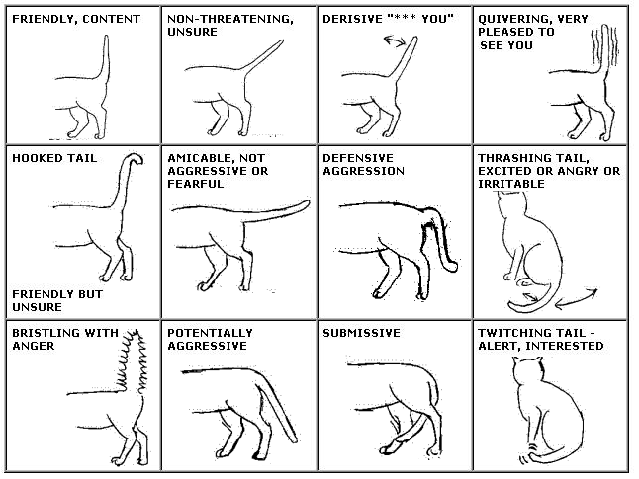
Cat Chat too - tail

Slide 57
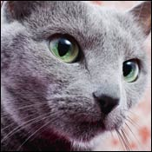
Watch the eyes

Slide 58
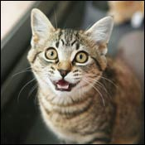
Eyes

Slide 59
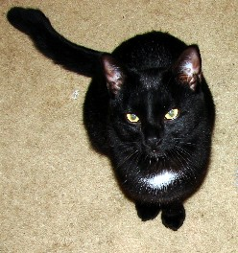
How is this cat feeling?

Slide 60
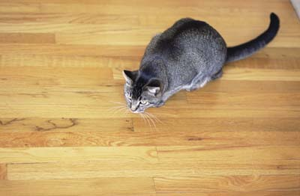
What is this cat about to do?

Slide 61
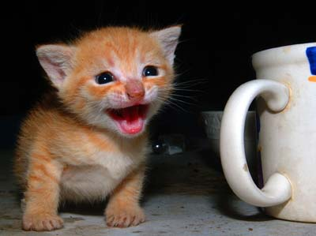
Is this kitten happy?

Slide 62
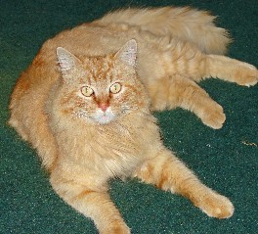
Watch for piloerection

Slide 63
Should you rub this cat’s belly?

